Slide 1
Group Discussion Assignment 4 Team 1 Language Detection using RNNs
Assia Bensafia Christian Clarke Darren Greway Zheng Tang
AI-574
Spring II 2026
Professor Srinivasan

Slide 2
Introduction
Language detection is an important task in natural language processing (NLP). It means automatically figuring out which language a piece of text is written in. This is useful in many everyday applications like search engines, translation tools, chatbots, and content filtering.
In this discussion, we treat language detection as a classification problem, where each sentence is assigned to one language. Instead of focusing on words, we use a character-level Recurrent Neural Network (RNN). This allows the model to learn patterns like letter combinations, accents, and writing styles that are unique to each language.
We use the Tatoeba dataset, which includes sentences in many different languages, to train and test our model. The goal is to build a system that can accurately recognize and distinguish between 10 common languages.

Slide 3
Objectives
Build a model to classify sentences into 10 languages
Represent text as character sequences
Design and implement an RNN-based architecture
Train and evaluate the model using the Tatoeba dataset
Measure performance using accuracy and confusion matrix

Slide 4
Data Source
Dataset Name: Tatoeba Project Dataset
Source: Community-contributed multilingual sentence collection
Languages Used: Top 10 most common languages (e.g., English, French, German, etc.)
Dataset Size:
Training Set: 10,000 sentences
Validation Set: 10,000 sentences
Data Format:
Column 1: Language Code (e.g., eng, fra, deu)
Column 2: Sentence Text
Preprocessing Steps:
Text cleaning and normalization
Conversion to character-level sequences
Padding sequences for batch processing

Slide 5
Approach
We use a character-level approach to model text for language detection. Instead of relying on words, the model learns patterns directly from sequences of characters, which helps capture subtle differences between languages such as accents and spelling variations. These sequences are then processed using an RNN to learn dependencies in the text.
Character-level representation of text
Convert sentences → sequences of character IDs
Apply padding to handle variable-length inputs
Use RNN (GRU) for sequence learning
Train model using batched data
Note: Language detection can often be efficiently modeled using classical ML. A simple Logistic Regression, for instance, attains a 99.3% accuracy on this dataset. For this experiment, we are interested in applying a neural network, but it is unlikely to outperform simpler models for this scenario.

Slide 6
Model Architecture
Component | Description
Embedding Layer | Converts character IDs into dense vector representations
RNN (GRU) | Processes sequences and learns language patterns from characters
Bidirectional (optional) | Captures context from both forward and backward directions
Dropout | Reduces overfitting and improves generalization
Fully Connected Layer | Maps learned features to language classes
Softmax Output | Converts scores into probabilities for final prediction
GRU vs LSTM Justification
GRU is selected due to its simpler architecture and fewer parameters, resulting in faster training and lower memory usage
The dataset contains relatively short sequences, so long-term dependencies are limited
Character-level language detection relies on local and mid-range patterns, which GRUs capture effectively
GRUs achieve comparable performance to LSTMs for similar sequence classification tasks
When LSTM would be preferred:
Very long sequences with complex temporal dependencies
Tasks requiring explicit memory control (forget gate)
Problems needing long-term context retention

Slide 7
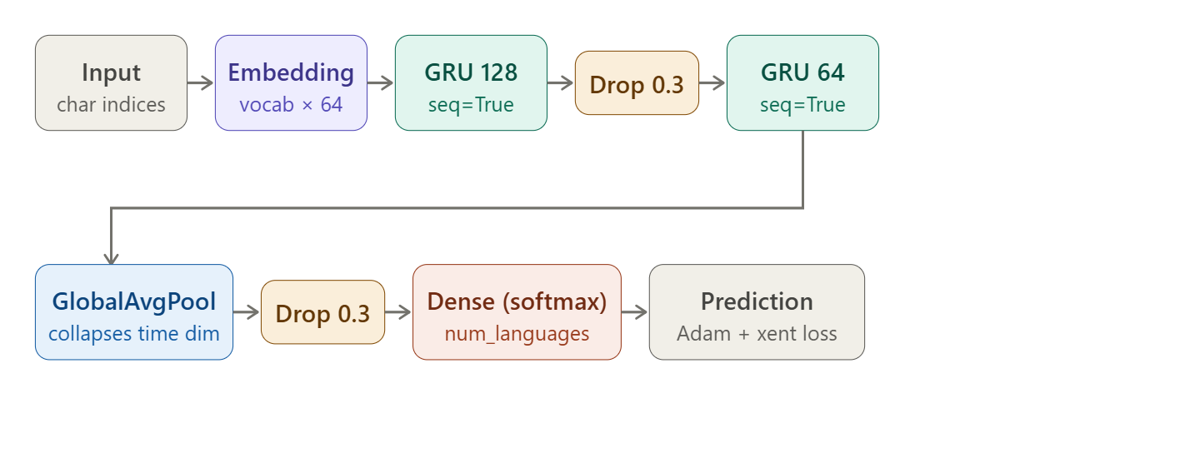
Proposed GRU Pipeline

Slide 8
Training Process
The model is trained using a supervised learning approach, where each input sentence is paired with its corresponding language label. First, sentences are converted into sequences of character IDs and padded to ensure consistent input lengths for batch processing. These sequences are then passed through the GRU model, which learns to capture patterns in the data. During training, we use the cross-entropy loss function to measure the difference between predicted and actual labels, and the Adam optimizer to update the model weights. The training process is repeated over multiple epochs, allowing the model to gradually improve its accuracy and generalize better to unseen data.

Slide 9
Evaluation Approach
Evaluation is performed using accuracy and F1-score as metrics, with a confusion matrix as a diagnostic for determining which language pairs are often mistaken and in which direction. Since the dataset is almost perfectly balanced, the average accuracy and F1-score should be useful measures. However, a per-class accuracy and F1-score could also be calculated to ensure performance is consistent across classes and the average does not hide poor prediction for a particular language.

Slide 10
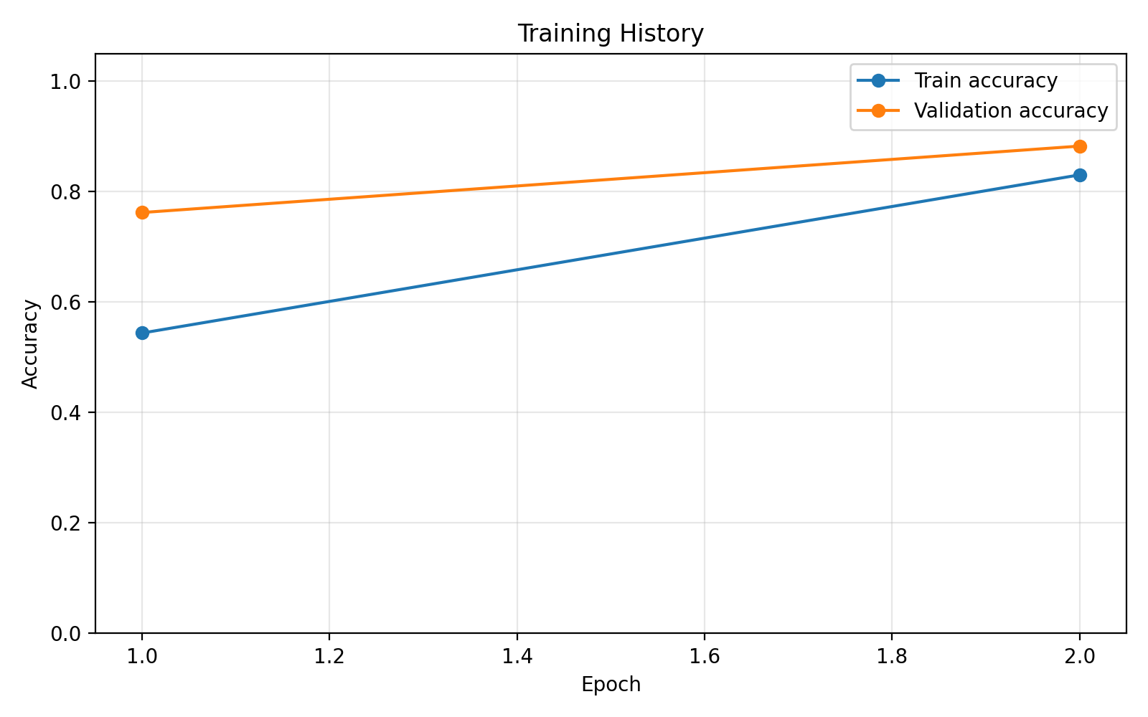
Evaluation / Results
Uing a preliminary baseline GRU stack:
Validation Accuracy: The model achieves high accuracy on the validation set, indicating good generalization to unseen data.
Training Performance: The training curves show increasing accuracy and decreasing loss, demonstrating effective learning over time.

Slide 11
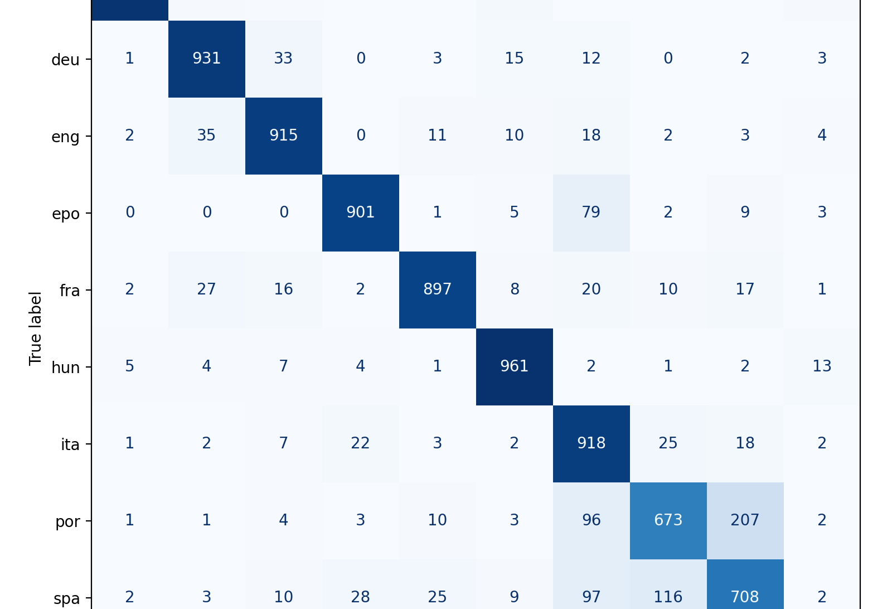
Evaluation / Results
Confusion Matrix Analysis The confusion matrix shows most predictions are correct, with some errors between similar languages.
Performance Across Languages The model performs better on languages with distinct patterns and slightly worse on similar ones such as Spanish/Portuguese/Italian.
Key Observations Errors mainly occur with short sentences and languages that share similar character structures.

Slide 12
Challenges
Similar languages (e.g., Portuguese vs Spanish): Languages with similar vocabulary and structure can confuse the model.
Short sentences: Limited context makes it harder to accurately identify the language.
Limited dataset size: Fewer examples can reduce the model’s ability to generalize.
Character overlap: Many languages share common characters, making distinctions more difficult.

Slide 13
Conclusion
In conclusion, this discussion assignment demonstrates that Recurrent Neural Networks are effective for language detection tasks. By using a character-level approach, the model is able to capture important linguistic patterns such as spelling, accents, and structure, which are essential for distinguishing between languages. Overall, the model achieves strong performance on multilingual data, showing its ability to generalize across different languages and sentence variations.

